Slide 1

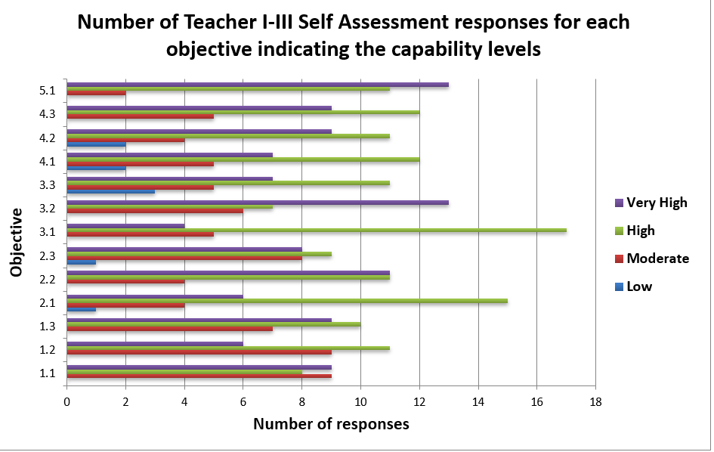
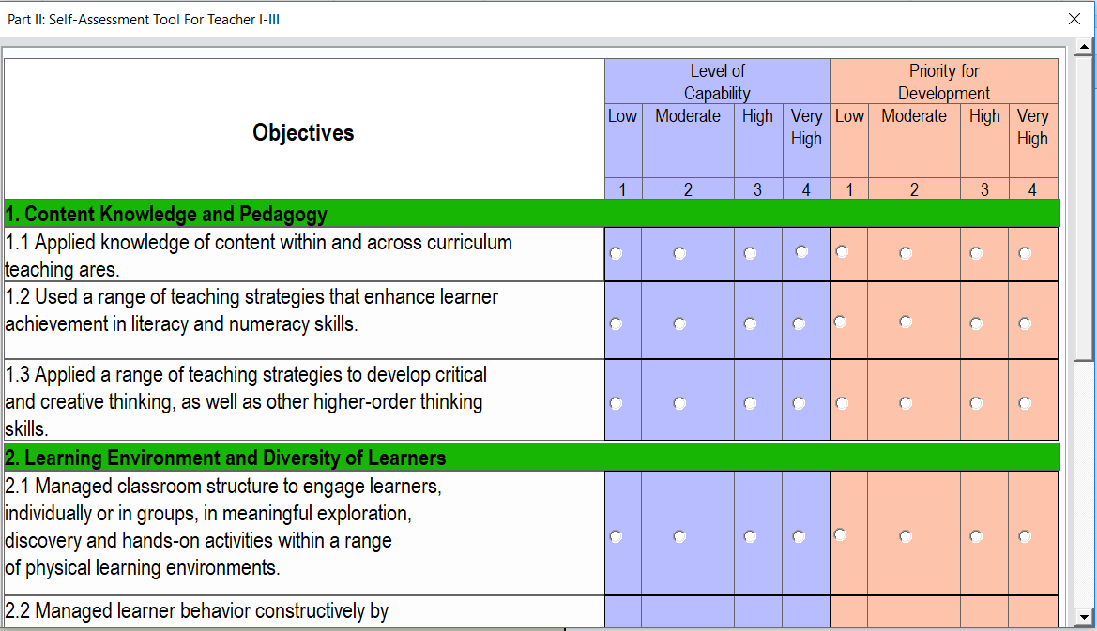
Electronic Self-assessment Tool (e-SAT)
Notes:
Purpose of the Slide:
To prompt participants on Electronic SAT (e-SAT).
Notes to Presenter:
This is a title slide.

Slide 2
Preliminaries
Notes:
Purpose of the Slide:
To prompt participants to the discussion on how teachers take the e-SAT file.
Notes to Presenter:
This is a title slide.

Slide 3
RPMS SELF-ASSESSMENT TOOLS
The Self-Assessment Tool is a common tool for assessing teacher performance that can be used as a starting point for informal purposes of self-reflection to:
clarify performance expectations and determine which competencies to focus on;
monitor the progression or improvement of teacher competencies;
validate whether the interventions provided are effective; and
guide discussions about goal-setting and professional development needs.

Slide 4



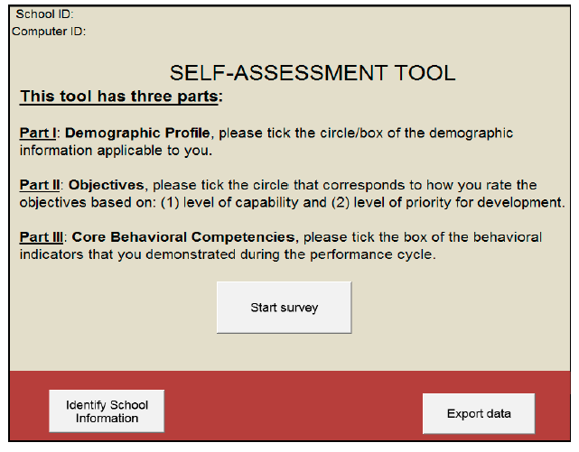
What is the electronic Self-assessment Tool (e-SAT)?
The electronic Self-Assessment Tool
(e-SAT) is an electronic version of the Self-Assessment Tool for RPMS.
Notes:
Purpose of the Slide:
To introduce the electronic SAT.
Notes to Presenter:
Note that the e-SAT is the electronic version of the SAT for RPMS.

Slide 5
What are the e-SAT Guides?
School ICT Coordinator
Teachers
School Heads
Opening and setting up the
e-SAT
Answering
e-SAT
Generating summary results of e-SAT data
Exporting
e-SAT data
Analyzing summary results of e-SAT data
Collecting
e-SAT data
The e-SAT Guide is a supplemental material to the RPMS Manual that will guide ICT personnel, teachers and school teachers in the administration of e-SAT.
Importing e-SAT data
Generating summary results of e-SAT data
Notes:
Purpose of the Slide:
To introduce the contents of the e-SAT guide for ICT personnel, teachers and personnel.
Notes to Presenter:
Discuss that:
the e-SAT Guide is a supplemental material to the RPMS Manual that will guide ICT personnel, teachers and school teachers in the administration of e-SAT.
for this session, the focus is on the parts that concern the teachers (answering e-SAT) and school heads (generating summary results of e-SAT data and analyzing summary results of e-SAT data). There will be a separate orientation/workshop for the ICT personnel on the e-SAT guide.

Slide 6


What are the e-SAT Guides?
The-SAT Guides is a supplemental material to the RPMS Manual that will guide:
School ICT Coordinator in a) preparing the e-SAT file; b) exporting data for collection; and c) importing data to generate summary results of teachers’ e-SAT data;
Teachers in accomplishing the e-SAT and printing their results for use in the preparation of their IPCRF-Development Plan; and
School Heads in extracting and analyzing the school-wide SAT data of teachers.

Slide 7

Observe CONFIDENTIALITY
Note that School Heads have access to the school-wide SAT data. The individual SAT data of a teacher can only be accessed by the concerned teacher.
The printout shall be given at once to the teacher and not be filed by the ICT Coordinator nor submitted to the Principal.
Notes:
Purpose of the Slide:
To emphasize the need for confidentiality of e-SAT data.
Notes to Presenter:
Emphasize that the self-assessment is a “low-stakes” assessment (compared to RPMS, which is “high-stakes” and is pertinent to other HR systems such as promotion and rewards). This only concerns the personal reflection of teachers of their performance, as honestly as possible.

Slide 8

How do we access the e-SAT Package?
Download the e-SAT.v8.zip from http://deped.in/eSATPackage
The Principal may request the assistance of the school ICT Coordinator in the management, administration and collection of the e-SAT data.
The e-SAT may be administered using one or more computers. In medium and big schools, you may set up as many computers as needed.
Notes:
Purpose of the Slide:
To continue discussion on the e-SAT.
Notes to Presenter:
Read the content of the slide.

Slide 9
What are the parts of the SAT?
Introduction
Demographic Profile
Objectives
Core Behavioral Competencies
Notes:
Purpose of the Slide:
To show the parts of the SAT.
Notes to Presenter:
Read through the slide.

Slide 10
What are the parts of the SAT?
Introduction
Demographic Profile
Objectives
Core Behavioral Competencies
Notes:
Purpose of the Slide:
To show the parts of the SAT.
Notes to Presenter:
Read through the slide.
This page introduces parts of the SAT-RPMS. It also consist the following buttons: i) Identify School Information; ii) Start Survey; and iii) Export data.

Slide 11
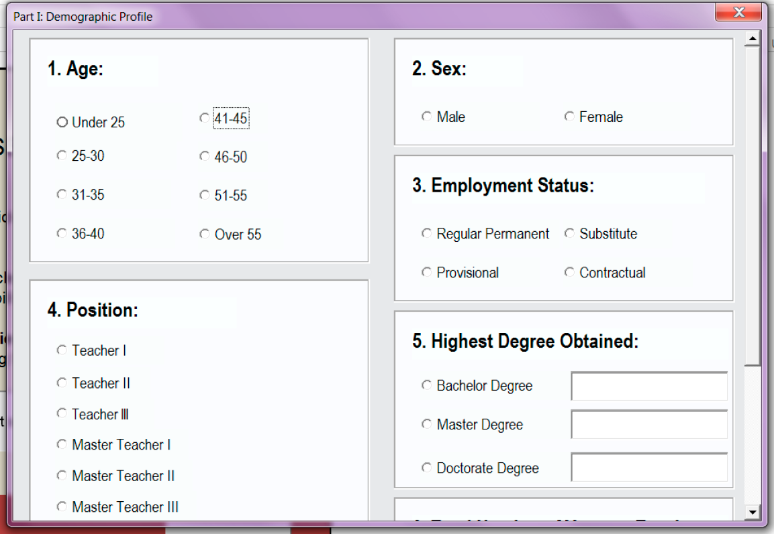
What are the parts of the SAT?
Introduction
Demographic Profile
Objectives
Core Behavioral Competencies
Notes:
Purpose of the Slide:
To introduce the Demographic Profile.
Notes to Presenter:
Discuss that:
This part collects the teacher’s demographic information, such as age, sex, rank or position, highest degree obtained, among others.
This slide is applicable to all (ICT coordinator, teachers who will answer the survey, and school heads).

Slide 12
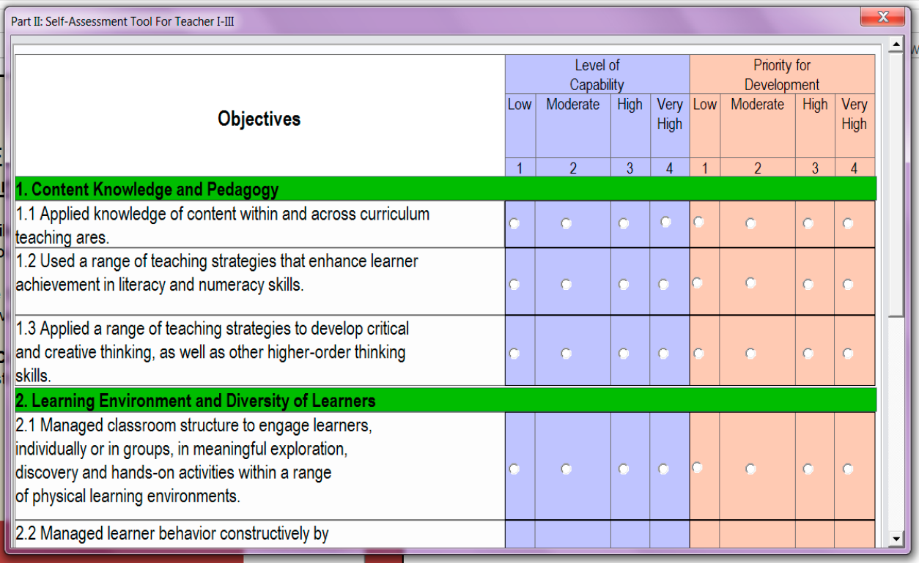
What are the parts of the SAT?
Introduction
Demographic Profile
Objectives
Core Behavioral Competencies
Notes:
Purpose of the Slide:
To introduce the Objectives as part of the e-SAT.
Notes to Presenter:
Discuss that:
This page contains the 13 objectives of the SAT-RPMS. Using a four-point Likert scale, the teachers will rate themselves in terms of how capable they are in performing each objective and what level of development priority they give to each objective.
This slide is applicable to all (ICT coordinator, teachers who will answer the survey, and school heads).

Slide 13
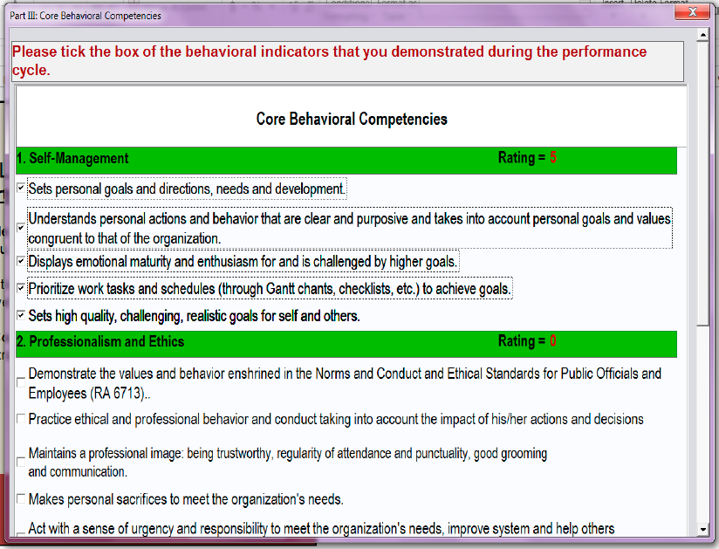
What are the parts of the SAT?
Introduction
Demographic Profile
Objectives
Core Behavioral Competencies
Notes:
Purpose of the Slide:
To introduce the Core Behavioral Competencies as part of the e-SAT.
Notes to Presenter:
Discuss that:
This part allows teachers to rate themselves in terms of the behavioral indicators that they demonstrate during the performance cycle. These competencies are the same for all DepEd personnel.
This slide is applicable to all (ICT coordinator, teachers who will answer the survey, and school heads).

Slide 14
What are the roles and responsibilities of the users of e-SAT?
Users | Roles and Responsibilities
Teachers | Take the e-SAT and answer it with utmost honesty. Print the results of the e-SAT and keep record of the printout. Prepare the IPCRF-Development Plan based on the e-SAT and discuss it with the School Head to come up with a final Development Plan
School Heads | With the assistance of the School ICT Coordinator: Facilitate the administration of e-SAT Generate summary results of teachers’ self-assessment Analyze and utilize the results of teachers’ self-assessment in designing development programs and activities for teachers at the school level. Discuss with the teacher in the finalization of their IPCRF-Development Plan. Submit the consolidated school-wide e-SAT data to the Schools Division Office
School ICT Coordinator | Assist the School Head in the following: Setting up and opening the e-SAT Survey file Collecting and exporting data (if multiple computers were used) Importing e-SAT data to Summary Reports file Generating summary results of teachers’ self-assessment Submitting school-wide e-SAT data to the Schools Division Office

Slide 15
eSAT Form for Teacher I-III
Which e-SAT form should Teachers and Master Teachers take?
The SAT-RPMS for Teacher I-III (Proficient Teachers) shall be used by Teacher I, Teacher II and Teacher III (TI-TIII), which include:
implementers of Alternative Learning System (ALS);
Madrasah Education teachers/Asatidz;
Indigenous Peoples Education (IPEd) teachers;
Special Education Teacher I-IV;
Senior High School teachers (including those who are in probationary status), and
Special Science Teacher I.

Slide 16
eSAT Form for Master Teacher I-IV
Which e-SAT form should Teachers and Master Teachers take?
The SAT-RPMS for Master Teacher I-IV (Highly Proficient Teachers) is for Master Teacher I to Master Teacher IV, which include:
implementers of Alternative Learning System (ALS);
Madrasah Education teachers/Asatidz;
Indigenous Peoples Education (IPEd) teachers;
Special Education Teacher V;
Senior High School teachers (including those who are in probationary status).

Slide 17

Why should you take the e-SAT?
The e-SAT is a self-assessment tool that helps you to reflect on the different objectives related to your professional work.
The results of the self-assessment will guide you on which RPMS indicators you must improve and the areas where you need coaching and mentoring.
Notes:
Purpose of the Slide:
To emphasize the importance of taking the e-SAT.
Notes to Presenter:
Refer back to Slide 3; that individual SAT / e-SAT result should only be seen by the one who took it.
Note that the more the survey becomes high stakes, respondents become less and less honest in accomplishing it. Confidentiality should be strictly observed to help teachers genuinely reflect; hence, giving out a more accurate result.

Slide 18
How do you open and set-up the e-SAT file?
Notes:
Purpose of the Slide:
To prompt participants to the discussion on how teachers take the e-SAT file.
Notes to Presenter:
This is a title slide.

Slide 19
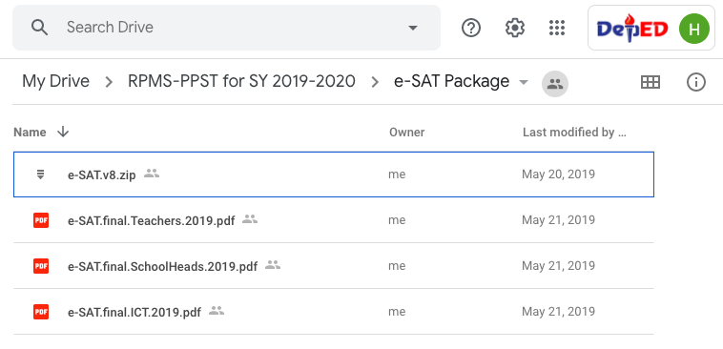
Download the e-SAT.v8.zip from http://deped.in/eSATPackage
The SAT folder and subfolders need to be extracted from the compressed folder file.

Slide 20
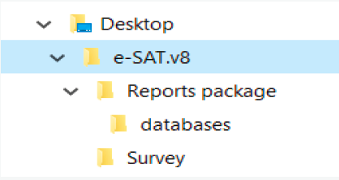
How do you open and set-up the e-SAT file?
Step 1. Extract the files.
Extract the e-SAT.v8 folder from the compressed folder file and save it on the Desktop.
Step 2. Open the SAT Survey file.
Go to your Desktop and open the folder. Inside, you will see two subfolders: a) Survey folder, which contains the e-SAT Excel file; and b) Reports Package folder, where you will store your exported data.

Slide 21



How do you open and set-up the e-SAT file?
Step 3. Enable Macros. Enable Editing. Then click Enable Macros.

Slide 22
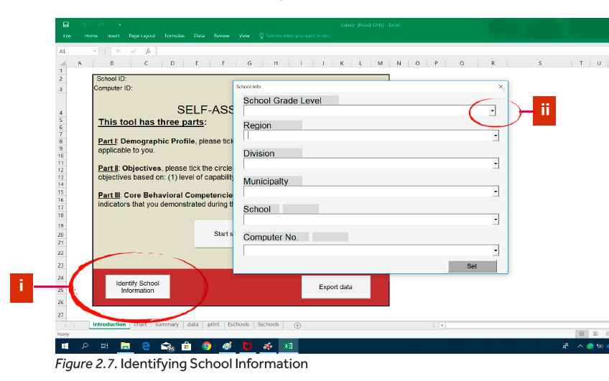
Step 4. Identify School Information and Computer ID
Click “Identify School Information”.
Input the needed information by clicking the drop down arrow. Select the grade level classification of your school, e.g., Elementary School or Secondary School, Region, Division, School.

Slide 23
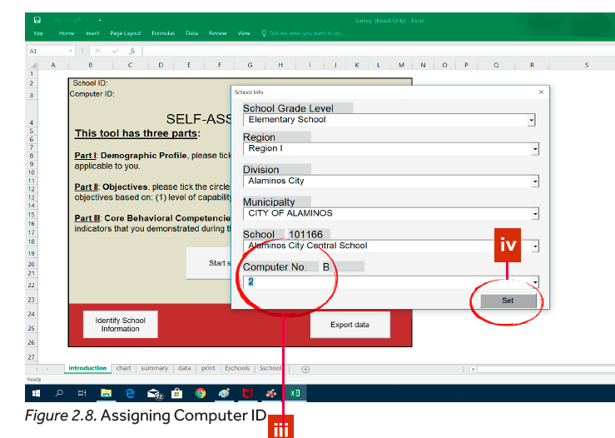
Assign Computer ID
If multiple computers will be used in accomplishing e-SAT, the ICT coordinator should assign number to each of the computers. The number corresponds to a letter, e.g., Computer 1 is A, Computer 2 is B, and so on. This will be the Computer ID.
Click “Set” if all the needed information have been provided.

Slide 24
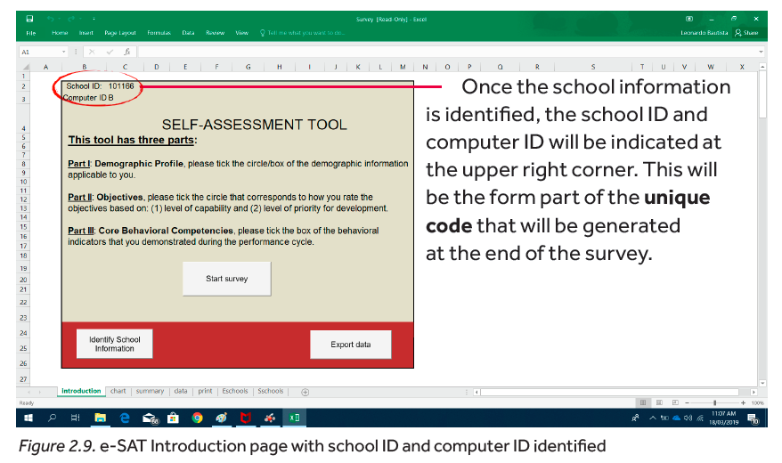
There are schools that have the same name within a Division/Region. Please ensure that you input the correct school by checking the School ID.
In cases where School/School ID cannot be found in the e-SAT, use the paper-and-pen version of SAT-RPMS. See pages 205-216 of the Updated RPMS Manual or visit:
http://deped.in/RPMSY1TOOLS2019

Slide 25
Once the e-SAT has been set up, Teachers can now take the electronic Self-Assessment Tool.
Please refer to e-SAT Guide for Teachers and Master Teachers.

Slide 26
How do you take the e-SAT file? (for Teachers)
Notes:
Purpose of the Slide:
To prompt participants to the discussion on how teachers take the e-SAT file.
Notes to Presenter:
This is a title slide.

Slide 27
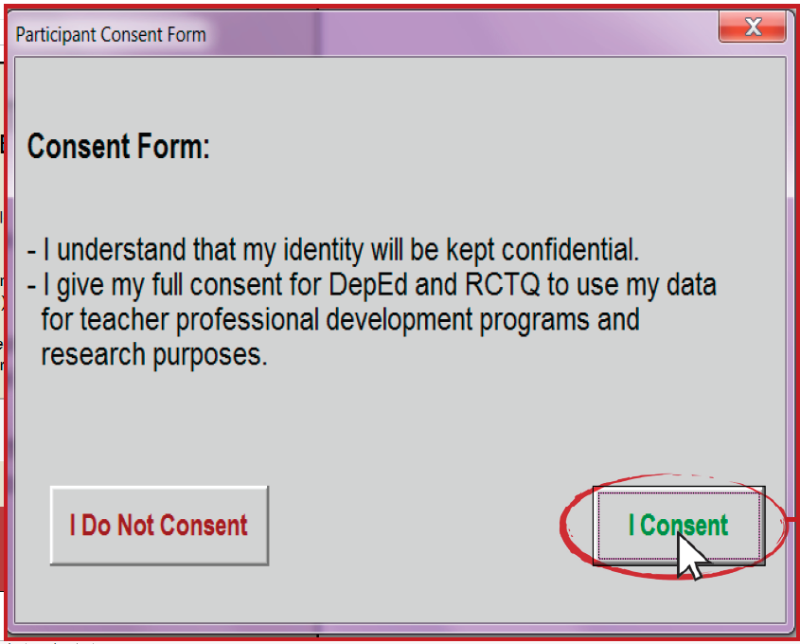
How do you take the e-SAT?
Step 1: Accomplish the Participant Consent Form.
Click “Start Survey” to begin.
Accomplish the Participant Consent Form by clicking “I Consent” or “I Do Not Consent”.
Notes:
Purpose of the Slide:
To discuss step 1 on accomplishing the e-SAT.
Notes to Presenter:
Discuss that:
Clicking “I Do Not Consent,” will bring back the teachers to the Introduction page and will not be able to complete the e-SAT. Clicking the “I Consent,” they will be redirected to the next page.
This slide is applicable to all but serves as a sweet reminder to our dear teachers.

Slide 28
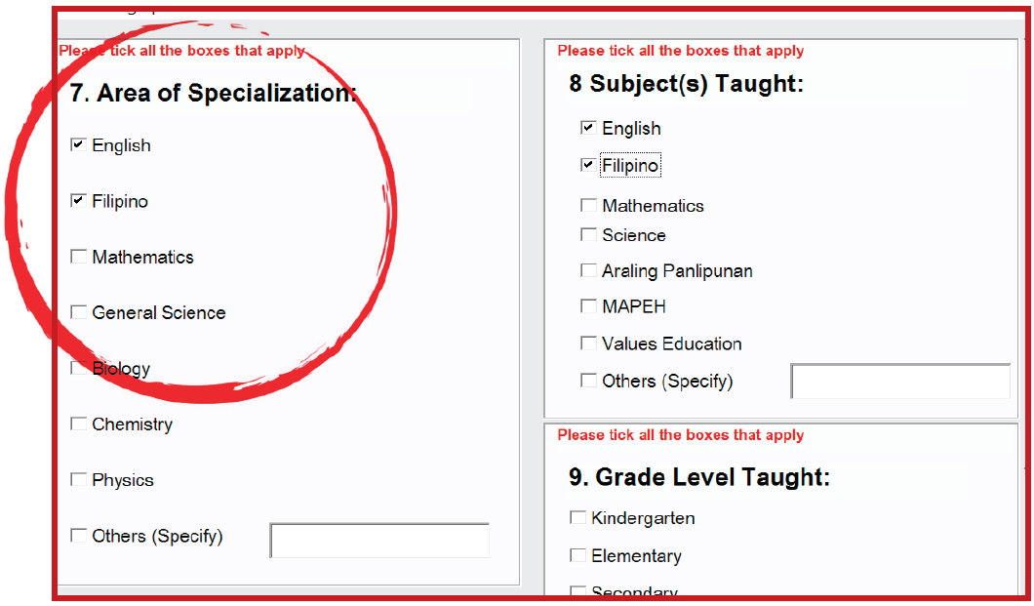
How do you take the e-SAT?
Step 2: Accomplish Part I: Demographic Profile.
Tick the circle of the demographic information applicable to you.
Scroll down to see and answer the rest of the items on the page.
Click “Next” to proceed to the next page.
Notes:
Purpose of the Slide:
To discuss step 2 on accomplishing the e-SAT.
Notes to Presenter:
Discuss that:
In some items, teachers can tick more than one box.
Teachers can also go back to the previous page by clicking “Previous”.
It is HIGHLY SUGGESTED that either the presenter demonstrates how to do this or s/he’d let one teacher do this hands-on.
This slide is applicable to all but serves as a sweet reminder to our dear teachers.

Slide 29
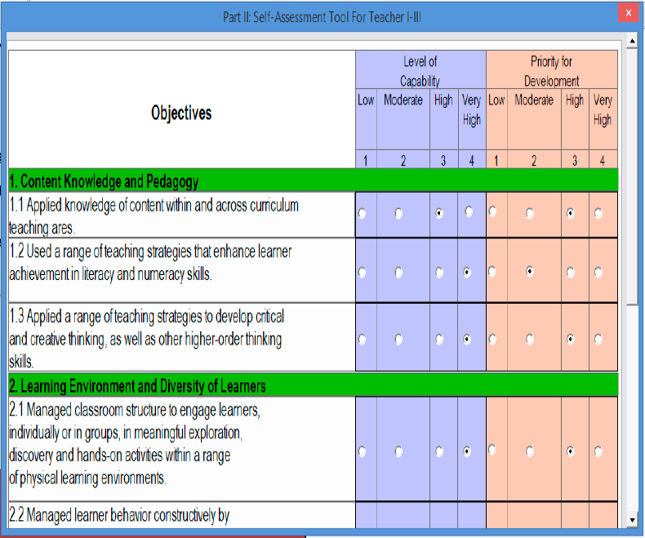
How do you take the e-SAT?
Step 3: Answer the e-SAT Objectives appropriate to your position.
Tick the circle that corresponds to how you rate the objectives based on: (1) level of capability and (2) level of priority for development.
Please answer the e-SAT objectives honestly.
Notes:
Purpose of the Slide:
To discuss step 3 on accomplishing the e-SAT.
Notes to Presenter:
Emphasize that there is a need to observe confidentiality so teachers can genuinely reflect while accomplishing this section of the survey.
Note that if they select Teacher I, Teacher II or Teacher III, they will be redirected to SAT-RPMS Teacher I-III. If they select Master Teacher I, Master Teacher II, Master Teacher III or Master Teacher IV, they will be redirected to SAT-RPMS Master Teacher I-IV.
Note that it is HIGHLY SUGGESTED that either the presenter demonstrates how to do this or s/he’d let one teacher do this hands-on.

Slide 30
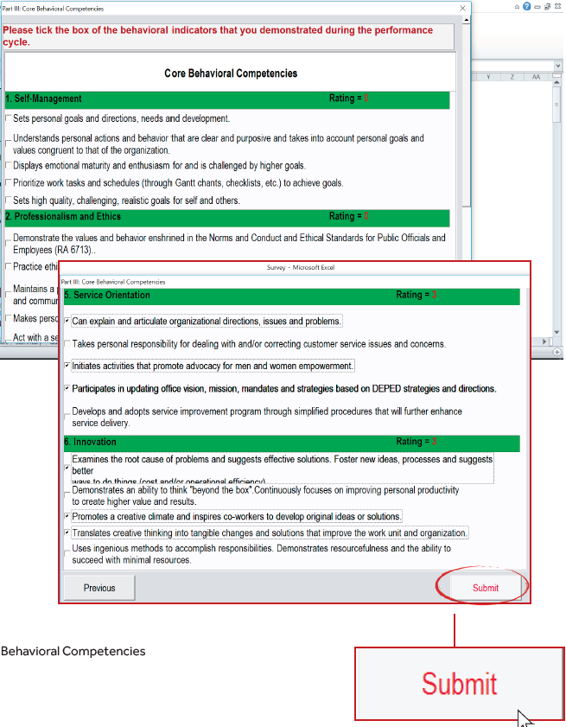
How do you take the e-SAT?
Step 4: Answer the Core Behavioral Competencies.
Tick the box of the behavioral indicators that you demonstrated during the performance cycle.
Click “Submit” when you are done.
Notes:
Purpose of the Slide:
To discuss step 4 on accomplishing the e-SAT.
Notes to Presenter:
Note that once teachers clicked the “Submit” button, they can no longer go back to previous pages to change their answers.
Remind teachers to review their responses by clicking the “Previous” button.
Note that it is HIGHLY SUGGESTED that either the presenter demonstrates how to do this or s/he’d let one teacher do this hands-on.

Slide 31
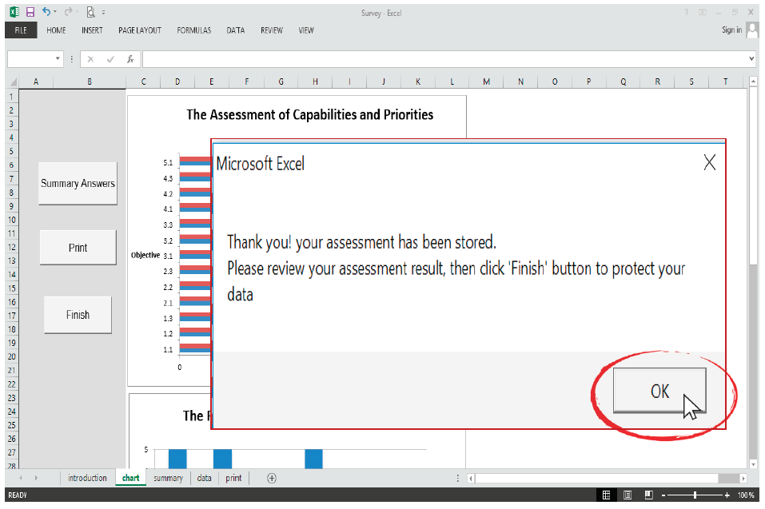
How do you take the e-SAT?
Step 5: View your assessment.
A dialog box will pop up, informing you that your assessment has been stored.
Click “OK”.
Notes:
Purpose of the Slide:
To discuss step 5 on accomplishing the e-SAT.
Notes to Presenter:
Discuss that:
Teachers can now view the assessment charts of their level of capability (blue bar) and level of priority (red bar), as well as their rating for their core behavioral competencies.
This slide is applicable to all but serves as a sweet reminder to our dear teachers.

Slide 32
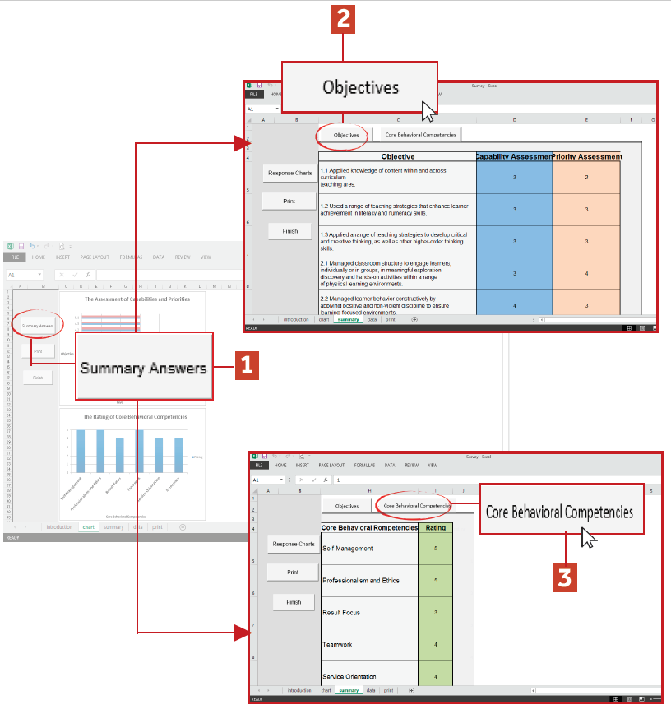
How do you take the e-SAT?
To review your assessment results:
Click “Summary Answers” to review your assessment results.
Click “Objectives” to review your assessment of e-SAT objectives.
Click “Core Behavioral Competencies” to review your rating of Core Behavioral Competencies.
Notes:
Purpose of the Slide:
To discuss how to review assessment results.
Notes to Presenter:
Note that it is HIGHLY SUGGESTED that either the presenter demonstrates how to do this or s/he’d let one teacher do this hands-on.
This slide is applicable to all but serves as a sweet reminder to our dear teachers.

Slide 33
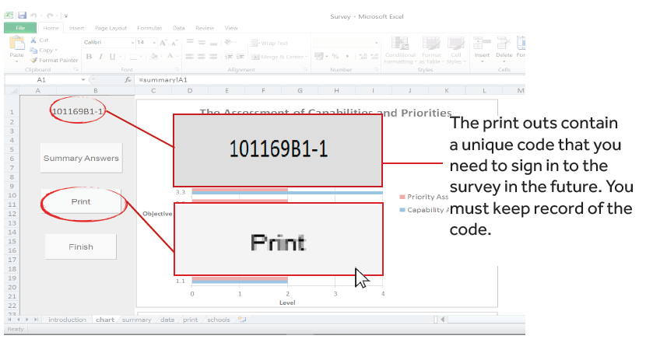
How do you take the e-SAT?
Step 6: Print your data.
Note: The ICT personnel should ensure that the computer is connected to the printer using the File and Print Options in MS Excel.
Notes:
Purpose of the Slide:
To discuss step 6 on accomplishing the e-SAT.
Notes to Presenter:
Discuss that the print outs contain a unique code that you need to sign in to the survey in the future. You must keep record of the code.
Note that this slide is applicable to all but serves as a sweet reminder to our dear teachers.

Slide 34
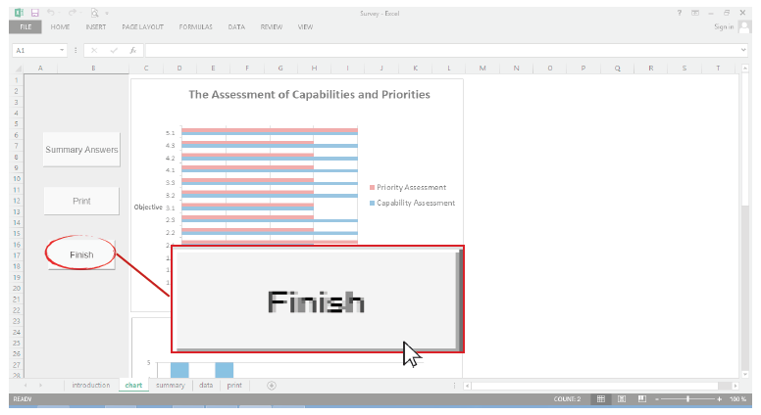
How do you take the e-SAT?
Step 7: Click “Finish” to protect your data.
Once you have printed your SAT data, click “Finish” to protect your data.
Notes:
Purpose of the Slide:
To discuss step 7 on accomplishing the e-SAT.
Notes to Presenter:
Note that:
The teacher will be brought back to the Introduction page. This means that their data has automatically been stored. (‘Has automatically been stored’ means teachers / respondents need not to click Save / Save As.)
The next teacher-respondent may now accomplish the e-SAT survey, following Steps 1-7.

Slide 35
(For ICT School Coordinator/School Head)
When all teachers have completed the e-SAT survey, you can now export and collect the e-SAT data.

Slide 36
How do you export the e-SAT file?
(for ICT Personnel)
Notes:
Purpose of the Slide:
To prompt participant (ICT Personnel) on the discussion about exporting the e-SAT file.
Note to Presenter:
This is a title slide.

Slide 37
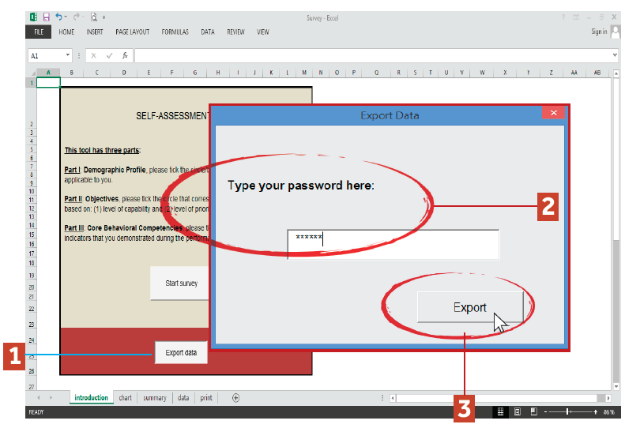
How do you export the e-SAT data?
When all teachers have completed the e-SAT survey, you can now export and collect the e-SAT data.
Step 1. Click “Export Data”.
Step 2. Enter “2018IT” as your password
Step 3. Click “Export”.
Notes:
Purpose of the Slide:
To prompt participant (ICT Personnel) on the discussion about exporting the e-SAT file.
Note to Presenter:
Note that:
This will answer concerns on how school heads will know his/her teachers’ needs when s/he isn’t allowed to see individual results: the file will automatically generate a summary through following the steps.
This slide is applicable particularly to the ICT coordinator.

Slide 38
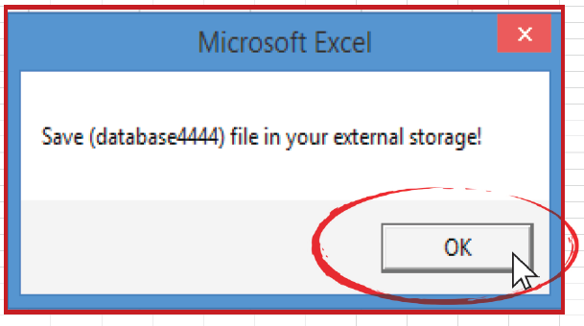
How do you export the e-SAT data?
Step 4. Save (databaseXXXX) file in your external storage.
Click “OK” on the dialog box and follow the destination path shown below:
1) Desktop > 2) SAT > 3) Reports Package > 4) databases > 5) Click “Save”
Notes:
Purpose of the Slides:
To show the steps in exporting the e-SAT data.
Notes to Presenter:
Note that:
This will answer concerns on how school heads will know his/her teachers’ needs when s/he isn’t allowed to see individual results: the file will automatically generate a summary through following the steps.
This slide is applicable particularly to the ICT coordinator.

Slide 39
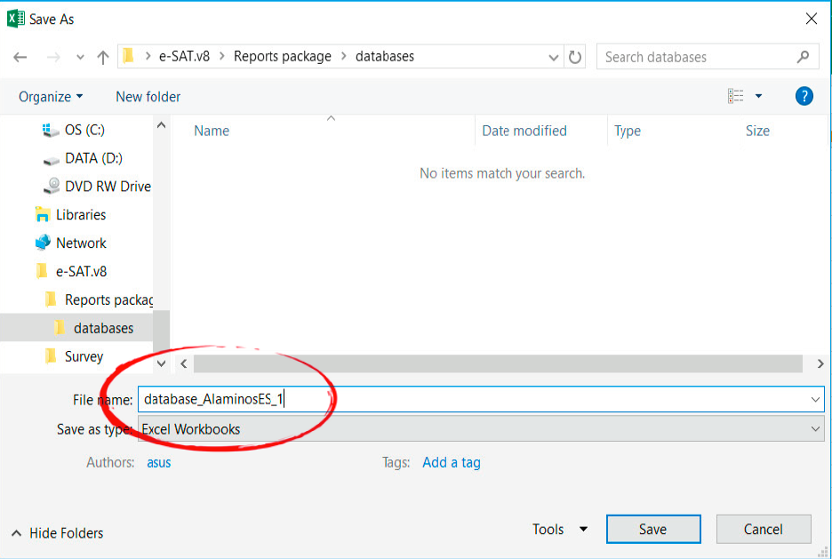
How do you export the e-SAT data?
Rename the file, following the convention:
database_name of school computer number
e.g. database_AlaminosES_1

Slide 40
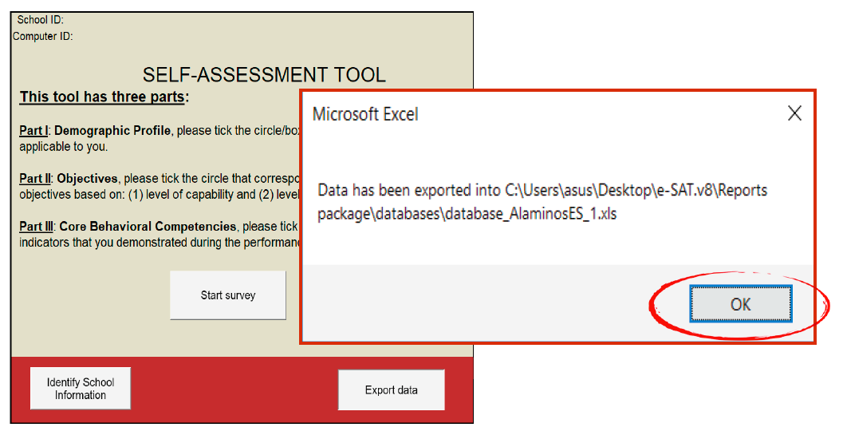
How do you export the e-SAT data?
A prompt will pop up to notify you that the data has been exported into the destination path.
You may now proceed to importing the database(s) using the Summary Reports file. Do not open the database file.
Notes:
Purpose of the Slides:
To show the steps in exporting the e-SAT data.
Notes to Presenter:
Note that:
This will answer concerns on how school heads will know his/her teachers’ needs when s/he isn’t allowed to see individual results: the file will automatically generate a summary through following the steps.
This slide is applicable particularly to the ICT coordinator.

Slide 41
How do you collect the e-SAT file?
(for ICT Personnel)
Notes:
Purpose of the Slide:
To prompt participant (ICT Personnel) on the discussion about collecting the e-SAT file.
Note to Presenter:
This is a title slide.

Slide 42
In the case of medium and big schools, several computers may be set up so teachers can accomplish their e-SAT simultaneously.
Hence, there is a need to collect database files from different computers and store or save them in the main computer.

Slide 43
How do you collect the e-SAT data from multiple computers?
Step 1. Export the e-SAT data once all teachers have completed the survey.
Step 2. Collect the database files from the computers and save them on the “databases” subfolder inside the e-SAT.v8.
On the Desktop of the computer, do the following:
Open the e-SAT.v8 folder.
Open the “Reports Package“ subfolder.
Open the “databases” folder.
Copy the “database” file and paste it in an external storage device, e.g., USB/flash drive.
Refer to pp. 19-20 of the e-SAT Guide for School ICT Coordinator
Notes:
Purpose of the Slide:
To discuss steps in collecting the e-SAT data from multiple computers.
Notes to Presenter:
Note that this slide is applicable particularly to the ICT coordinator to show how to ‘harvest’ files from multiple computers.
Read through the slide.

Slide 44
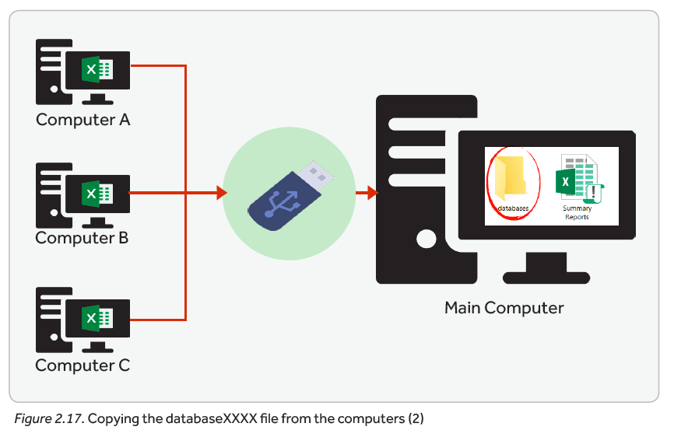
How do you collect the e-SAT data from multiple computers?
Step 3. Go to your designated “main” computer and do the following:
Open the SAT folder, the “Reports Package” folder and the “databases” folder.
Paste the “database” files that you collected from the computers on the “databases” folder.
Refer to pp. 19-20 of the e-SAT Guide for School ICT Coordinator
Notes:
Purpose of the Slide:
To discuss steps in collecting the e-SAT data from multiple computers.
Notes to Presenter:
Note that this slide is applicable particularly to the ICT coordinator to show how to ‘harvest’ files from multiple computers.
Read through the slide.

Slide 45
How do you generate summary results of the e-SAT file?
(for School Head and ICT Personnel)
Notes:
Purpose of the Slide:
To prompt participant (ICT Personnel) on the discussion about generating summary results of the e-SAT file.
Note to Presenter:
This is a title slide.

Slide 46
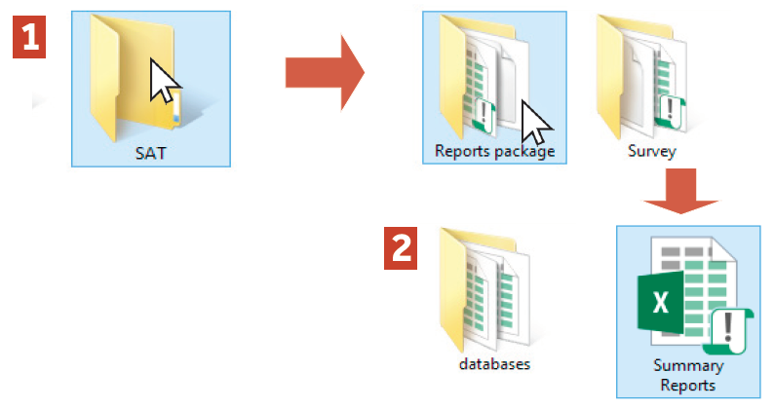
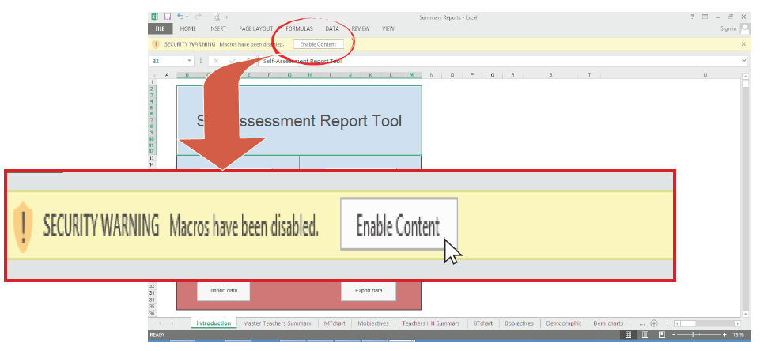
How do you generate summary results of teachers’ data?
Step 1. Open the Summary Reports Excel file.
To open the file:
Open the SAT folder, then the “Reports Package” folder.
Open the “Summary Reports.xlsm” file.
Step 2. Enable Macros
Notes:
Purpose of the Slide:
To show steps in generating summary results of teachers’ data.
Notes to Presenter:
Go through the steps.

Slide 47
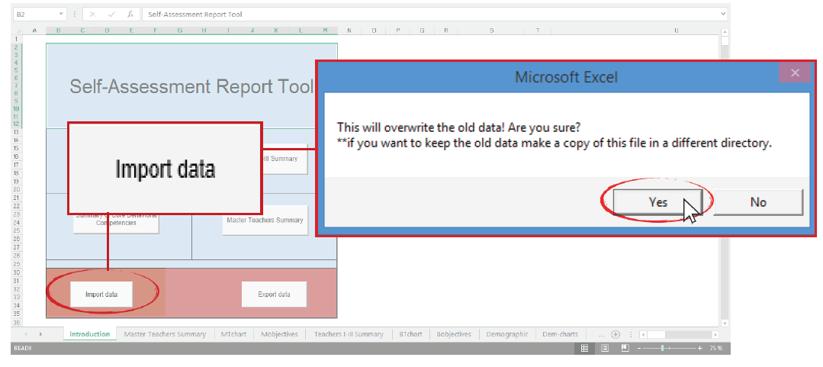
How do you generate summary results of teachers’ data?
Step 3. Import Data.
How do you import the e-SAT data?
Click “Import Data”. A dialogue window will prompt you to overwrite the old data. Click “Yes” to continue.
It may take several minutes for the system to import the databases.
Notes:
Purpose of the Slide:
To show steps in generating summary results of teachers’ data.
Notes to Presenter:
Go through the step.

Slide 48
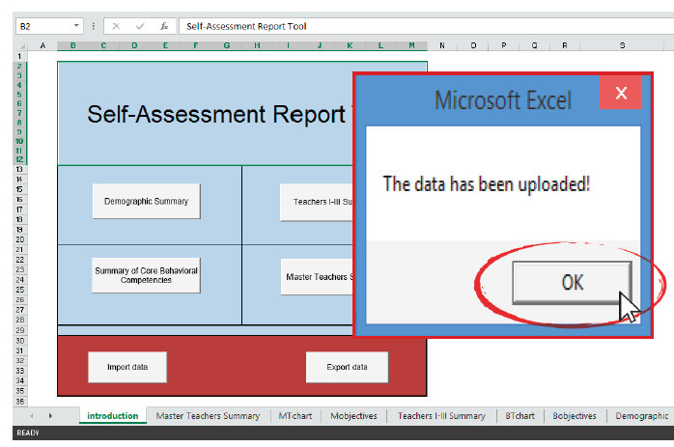
How do you generate summary results of teachers’ data?
Another prompt will pop up to indicate that the data has been uploaded. Click “OK” to continue.
Notes:
Purpose of the Slide:
To show steps in generating summary results of teachers’ data.
Notes to Presenter:
Go through the steps.

Slide 49
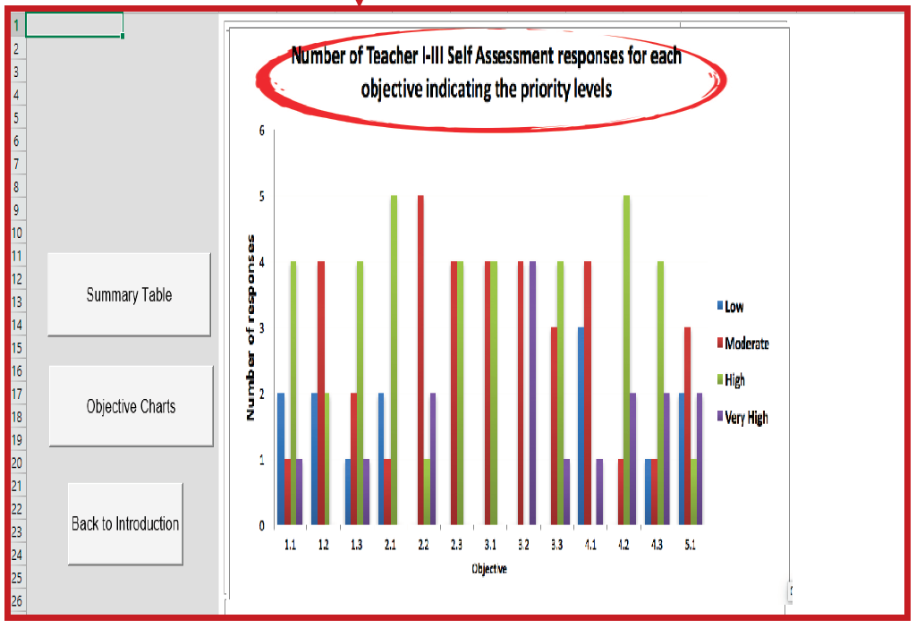
How do you generate summary results of teachers’ data?
Click “Summary Charts” to see charts showing teachers’ responses for each objective in terms of:
level of capability; and
level of priority for development.
Notes:
Purpose of the Slide:
To discuss the steps in generating summary results of teachers’ data.
Notes to Presenter:
Note that this will answer concerns on how school heads will know his/her teachers’ needs when s/he isn’t allowed to see individual results: the file will automatically generate a summary through following the steps.
Click to see succeeding slides.

Slide 50
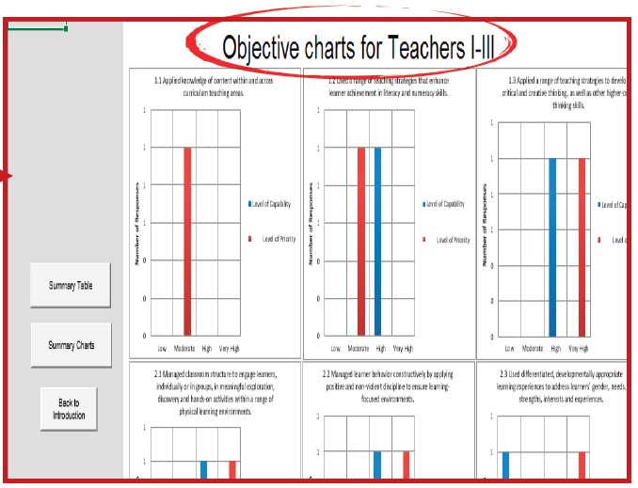
How do you generate summary results of teachers’ data?
Click “Objective Charts” to see charts per objective.
Notes:
Purpose of the Slide:
To discuss the steps in generating summary results of teachers’ data.
Notes to Presenter:
Note that this will answer concerns on how school heads will know his/her teachers’ needs when s/he isn’t allowed to see individual results: the file will automatically generate a summary through following the steps.
Click to see succeeding slides.

Slide 51
How do you generate summary results of teachers’ data?
Generate summary results of teachers’ e-SAT data.
Click on the appropriate button to generate summary table or charts of results that you need to plan for teachers’ professional development.
Demographic Summary Results. Tables of summary results of teachers’ demographic information can be generated by clicking “Demographic Summary”. Demographic charts can also be generated if you click “Demographic Charts”.
Notes:
Purpose of the Slide:
To show the steps in generating summary results of teachers’ data.
Notes to Presenter:
Note that:
This slide is for the school head.
This will answer concerns on how school heads will know his/her teachers’ needs when s/he isn’t allowed to see individual results: the file will automatically generate a summary through following the steps.
Go through the step.

Slide 52
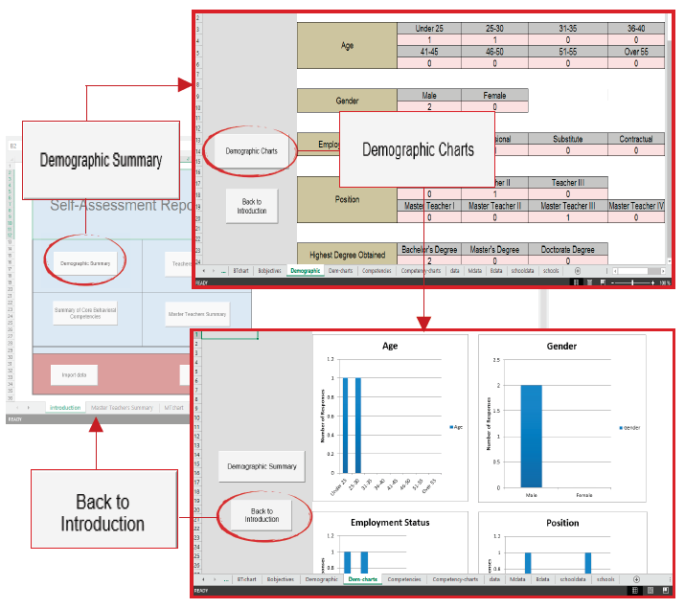
Click “Back to Introduction” to go back to the Introduction page.
Notes:
Purpose of the Slide:
To discuss steps in generating summary results of teachers’ data.
Notes to Presenter:
Go through the steps.

Slide 53
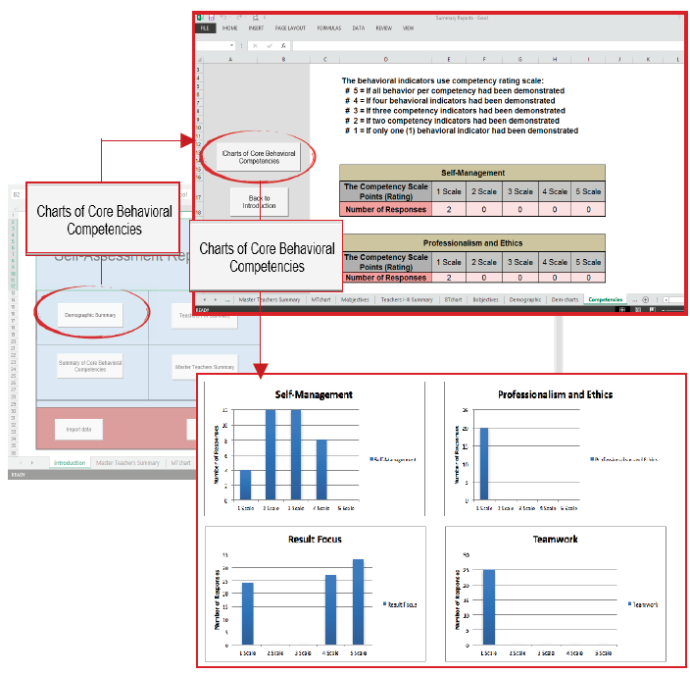
Summary of Core Behavioral Competencies.
Click “Summary of Core Behavioral Competencies” to generate summary tables of teachers’ rating of core behavioral competencies. Charts may also be generated if you click “Charts of Core Behavioral Competencies”.
Notes:
Purpose of the Slide:
To discuss steps in generating summary results of teachers’ data.
Notes to Presenter:
Go through the steps.

Slide 54
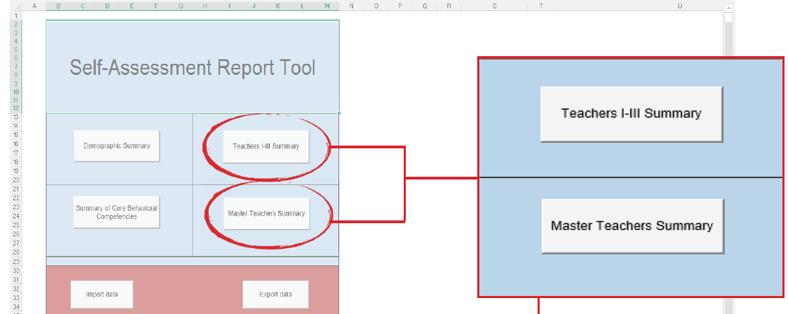
How do you generate summary results of teachers’ data?
Teachers I-III and Master Teachers Summary. The tables and charts of summary results of Teacher I-III’s and Master Teachers’ assessment can also be generated through the e-SAT.
Click “Teachers I-III Summary” or “Master Teachers Summary” to see summary table of frequency distribution of responses per objective of teachers and Master Teachers.
Notes:
Purpose of the Slide:
To discuss steps in generating summary results of teachers’ data.
Notes to Presenter:
Go through the steps.

Slide 55
What data can be generated from the e-SAT school-wide data? (for School Heads)
Notes:
Purpose of the Slide:
To prompt participant (School Heads) on the discussion about the data generated from the e-SAT school-wide data.
Notes to Presenter:
This is a title slide.

Slide 56


The following data can be generated from the e-SAT:
What data can be generated from the e-SAT school-wide data?
Summary of teachers’ demographic profile
Summary of teachers’ rating of core behavioral competencies
Summary of Teachers’ and Master Teachers’ self-assessment rating
Notes:
Purpose of the Slides:
To discuss data that can be generated from the e-SAT.
Notes to Presenter:
Note that in the Summary Reports excel file of the e-SAT package, the following button can be clicked to see the corresponding data.

Slide 57
The following data can be generated from the e-SAT:
What data can be generated from the e-SAT school-wide data?
Summary of teachers’ demographic profile
Summary of teachers’ rating of core behavioral competencies
Summary of Teachers’ and Master Teachers’ self-assessment rating
Notes:
Purpose of the Slides:
To discuss data that can be generated from the e-SAT.
Notes to Presenter:
Note that in the Summary Reports excel file of the e-SAT package, the following button can be clicked to see the corresponding data.

Slide 58
The following data can be generated from the e-SAT:
What data can be generated from the e-SAT school-wide data?
Summary of teachers’ demographic profile
Summary of teachers’ rating of core behavioral competencies
Summary of Teachers’ and Master Teachers’ self-assessment rating
Notes:
Purpose of the Slides:
To discuss data that can be generated from the e-SAT.
Notes to Presenter:
Note that in the Summary Reports excel file of the e-SAT package, the following button can be clicked to see the corresponding data.

Slide 59
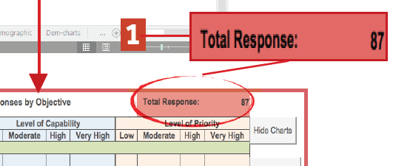
What data can be generated from the e-SAT school-wide data?
In the summary table, you can see the:
Total number of responses;
Total number of responses per scale per indicator; and
Chart per objective
Notes:
Purpose of the Slide:
To discuss the steps in generating summary results of teachers’ data.
Note to Presenter:
Note that this will answer concerns on how school heads will know his/her teachers’ needs when s/he isn’t allowed to see individual results: the file will automatically generate a summary through following the steps.
Click to see succeeding slides.

Slide 60
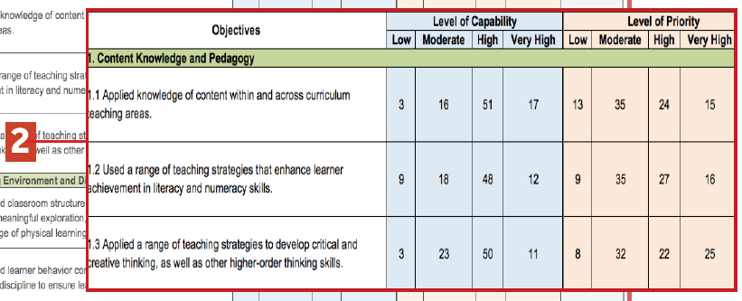
What data can be generated from the e-SAT school-wide data?
In the summary table, you can see the:
Total number of responses;
Total number of responses per scale per indicator; and
Chart per objective
Notes:
Purpose of the Slide:
To discuss the steps in generating summary results of teachers’ data.
Notes to Presenter:
Note that this will answer concerns on how school heads will know his/her teachers’ needs when s/he isn’t allowed to see individual results: the file will automatically generate a summary through following the steps.
Click to see succeeding slides.

Slide 61
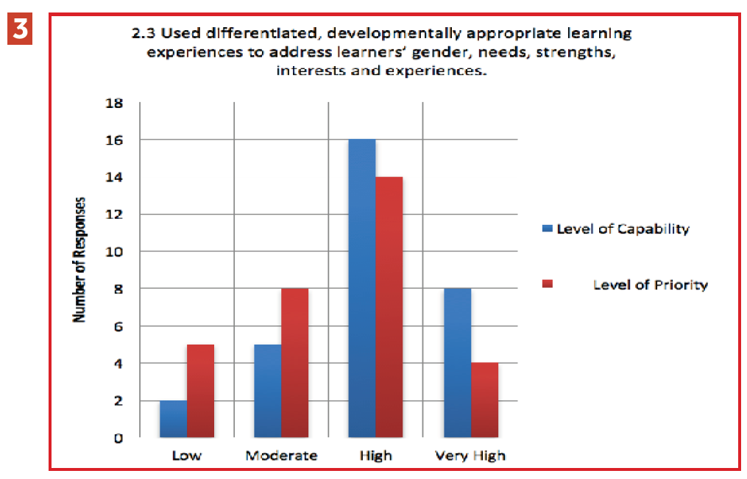
What data can be generated from the e-SAT school-wide data?
In the summary table, you can see the:
Total number of responses;
Total number of responses per scale per indicator; and
Chart per objective
Notes:
Purpose of the Slide:
To discuss the steps in generating summary results of teachers’ data.
Notes to Presenter:
Note that this will answer concerns on how school heads will know his/her teachers’ needs when s/he isn’t allowed to see individual results: the file will automatically generate a summary through following the steps.
Click to see succeeding slides.

Slide 62
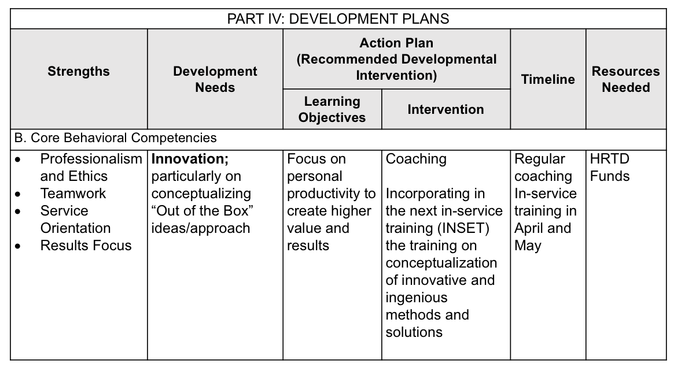
Why do you need the summary results of teachers’ data?
This can help you prepare the school development plans and other various development interventions in preparation for the next school year.
The summary results of teachers’ data can provide you an overall picture of your teachers’ strengths and needs.
Notes:
Purpose of the Slide:
To emphasize the importance of the summary results of teachers’ data
Notes to Presenter:
Note that:
This slide is for the school head (to be helped by the ICT coordinator especially in importing data).
This will answer concerns on how school heads will know his/her teachers’ needs when s/he isn’t allowed to see individual results.

Slide 63
How do teachers use the results of the e-SAT data? (for Teachers)
Notes:
Purpose of the Slide:
To prompt participant (School Heads) on the discussion about the data generated from the e-SAT school-wide data.
Notes to Presenter:
This is a title slide.

Slide 64
How do Teachers use the results of e-SAT?
Step 1: The teacher prepares the Development Plan based on the results of SAT-RPMS.
The teacher can reflect in the plan as development needs the objectives that rated “Low” in terms of level of capability, or “High” or “Very High” in terms of priority for development.
The objectives rated “High” or “Very High” in terms of level of capability can be reflected as strengths in the Development Plan.
See Figure 6.11 for the sample accomplished Part IV: Development Plans (IPCRF-DP) based on the SAT-RPMS results. Follow the steps in Chapter 3, page 52, in preparing for the Part IV: DP.
Note: IPCRF-Development Plan should be accomplished by teachers individually.
Notes:
Purpose of the Slide:
To show the different summary of teachers’ data.
Notes to Presenter:
Read through the slide.

Slide 65
How do Teachers use the results of e-SAT?
Step 2: The teacher discusses the Development Plan with the Principal.
Step 3: The teacher and the School Head come to an agreement about the final Development Plan.
The IPCRF-DP shall be updated during Phase 4: Performance Rewarding and Development Planning and shall be informed by the actual ratings of the IPCRF in Phase 3: Performance Review and Evaluation.
Notes:
Purpose of the Slide:
To show the different summary of teachers’ data.
Notes to Presenter:
Read through the slide.

Slide 66
Sample Accomplished IPCRF-Development Plan based on the results of Self-Assessment
PART IV: DEVELOPMENT PLANS
Strengths | Development Needs | Action Plan (Recommended Developmental Intervention) |  | Timeline | Resources Needed
 |  | Learning Objectives | Intervention
A. Functional Competencies
Objective 9, KRA 3 To select, develop, organize and use appropriate teaching and learning resources, including ICT, to address learning goals. |  | Enrich skills in developing and organizing localized and indigenized materials that are aligned with the learning goals. | Participating in seminars/ workshops Participating in Learning Action Cells (LAC) | Year-round | Supervisors / School Heads / Master Teachers Local Funds

Slide 67
Sample Accomplished IPCRF-Development Plan based on the results of Self-Assessment
PART IV: DEVELOPMENT PLANS
Strengths | Development Needs | Action Plan (Recommended Developmental Intervention) |  | Timeline | Resources Needed
 |  | Learning Objectives | Intervention
A. Functional Competencies
 | Objective 5, KRA 2 To manage learner behavior constructively by applying positive and non-violent discipline to ensure learning-focused environments; particularly on how to respond appropriately to misbehavior of learners at all times without any loss of instructional time. | Learn non-verbal strategies/cues to manage misbehavior of learners at all times without any loss of instructional time | Seeking advice, asking opinions, sounding out ideas from colleagues/ mentors Participating in Learning Action Cells (LAC) Requesting coaching from manager/others | Year-round | Supervisors / School Heads / Master Teachers Local Funds

Slide 68
Sample Accomplished IPCRF-Development Plan based on the results of Self-Assessment
PART IV: DEVELOPMENT PLANS
Strengths | Development Needs | Action Plan (Recommended Developmental Intervention) |  | Timeline | Resources Needed
 |  | Learning Objectives | Intervention
A. Functional Competencies
Objective 3, KRA 1 To apply a range of teaching strategies to develop critical and creative thinking, as well as other higher-order thinking skills. | Objective 3, KRA 1 To apply a range of teaching strategies to develop critical and creative thinking, as well as other higher-order thinking skills; particularly, to improve on my art of questioning so that I will be able to make my students use and develop their critical thinking skills | Acquire techniques and strategies on the art of questioning that will enable to develop HOTS among the students. | Applying new learning from attending courses/seminars/ workshops/ Learning Action Cells (LAC)/ E-learning Using feedback to try a new approach to an old practice Coaching and mentoring | Year-round | Learning and Development Team Supervisors / School Heads / Master Teachers Local Funds

Slide 69
Sample Accomplished IPCRF-Development Plan based on the results of Self-Assessment
PART IV: DEVELOPMENT PLANS
Strengths | Development Needs | Action Plan (Recommended Developmental Intervention) |  | Timeline | Resources Needed
 |  | Learning Objectives | Intervention
B. Core Behavioral Competencies
Professionalism and Ethics Teamwork Service Orientation Results Focus | Innovation; particularly on conceptualizing “Out of the Box” ideas/approach | Focus on personal productivity to create higher value and results | Coaching Incorporating in the next in-service training (INSET) the training on conceptualization of innovative and ingenious methods and solutions | Regular coaching In-service training in April and May | HRTD Funds

Slide 70
Useful Links:
ESAT Package:
http://deped.in/eSATPackage
Updated RPMS Manual:
http://deped.in/RPMSManualver2019
Updated RPMS Tools:
http://deped.in/RPMSY1TOOLS2019

Slide 71
Presentation slides Dr. Gina O. Gonong Director, RCTQ Mikkey Mari M. Tuazon
Research Officer, RCTQ
Michael Wilson I. Rosero
Project Development III, BHROD-HRDD

